Slide 1
PrEP Considerations for HPX3002/HVTN 706
Susan Buchbinder
HVTN Study Chair/San Francisco Site PI

Slide 2
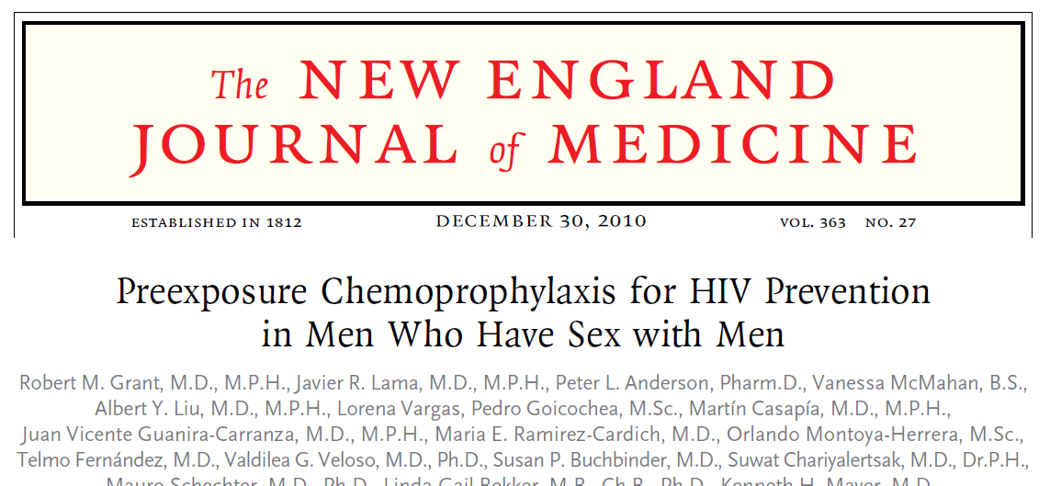
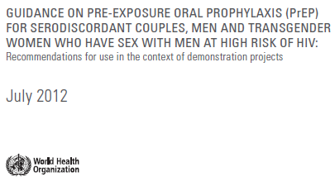
PrEP is safe and highly effective against sexual exposures for MSM and TGW

Slide 3
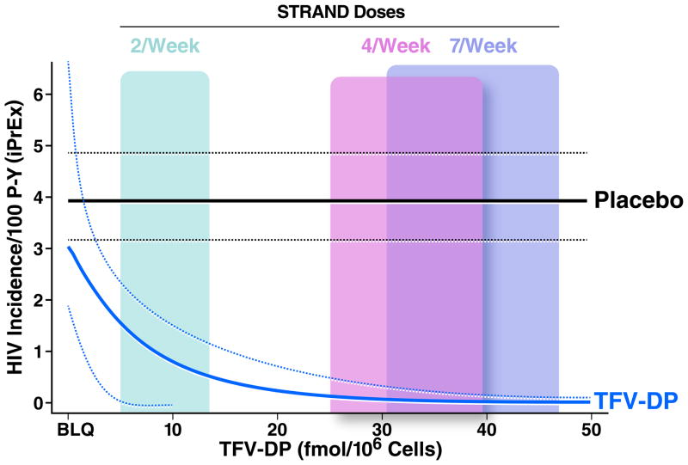
4 Doses/Week has Similar Efficacy to Daily TDF/FTC for MSM
# Doses/ week | Estimated efficacy | 95% CI
2 | 76% | 56-96%
4 | 96% | 90%->99%
7 | 99% | 96%->99%
Anderson et al, Sci Transl Med 2012;4 (151):151ra125

Slide 4
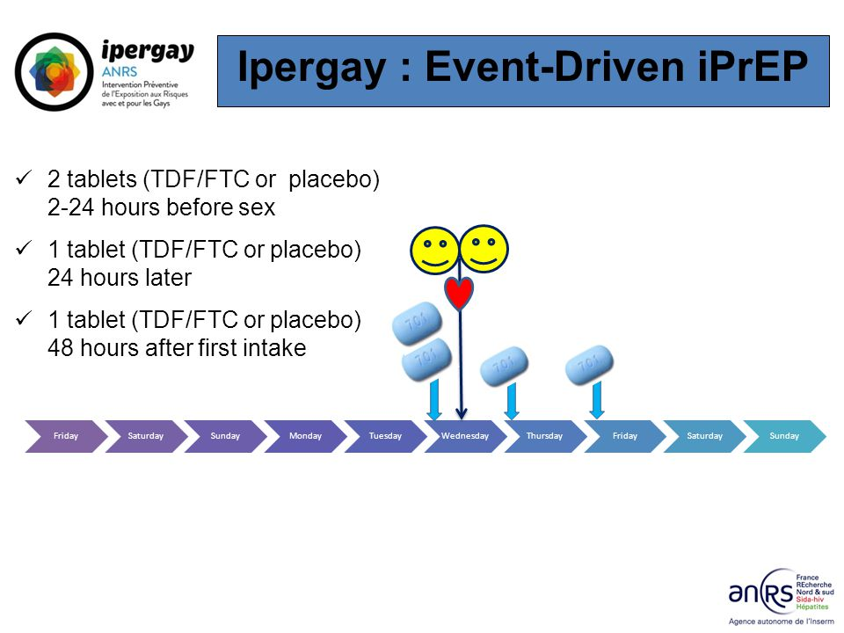
“2-1-1 or on-demand PrEP”

Slide 5


Ipergay Results
HIV Incidence (mITT Analysis)
Treatment | Follow-Up Pts-years | HIV Incidence per 100 Pts-years (95% CI)
Placebo (double-blind) | 212 | 6.60 (3.60-11.1)
TDF/FTC (double-blind) | 219 | 0.91 (0.11-3.30)
TDF/FTC (open-label) | 515 | 0.19 (0.01-1.08)
Median Follow-up in Open-Label Phase 18.4 months (IQR:17.5-19.1)
97% relative reduction vs. placebo
Molina et al, Lancet HIV 2017;4:e402-10
Notes:
5
5
Figure 2. Kaplan–Meier Estimates of Time to HIV Infection (Modified Intention-to-Treat Population). The cumulative probability of HIV acquisition is shown for the two study groups. The efficacy of preexposure prophylaxis with emtricitabine and tenofovir disoproxil fumarate (FTC–TDF) was 44%, as compared with placebo (P=0.005). The inset graph shows a more detailed version of the overall graph up to a probability of 0.10.

Slide 6
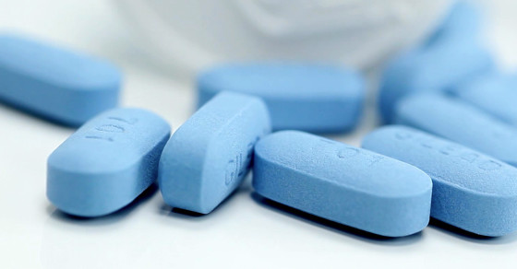
With an effective product, three design choices in future RCTs
Compare
Compare experimental product (EXP) to existing prevention (FTC/TDF)
Layer
Compare EXP to placebo (PBO) on top of use of existing prevention
Combine
Compare existing prevention combined with EXP product
FTC/TDF
EXP
Placebo
EXP
FTC/TDF+ Placebo
FTC/TDF + EXP
Slide courtesy of Deborah Donnell

Slide 7
With an effective product, three design choices in future RCTs
Compare
Compare experimental product (EXP) to existing prevention (FTC/TDF)
Layer
Compare EXP to placebo (PBO) on top of use of existing prevention
Combine
Compare existing prevention combined with EXP product
FTC/TDF
EXP
Placebo
EXP
FTC/TDF+ Placebo
FTC/TDF + EXP
Slide courtesy of Deborah Donnell

Slide 8
Standard of Prevention : moving target
5%
PrEP Uptake
24%

Slide 9
Trying to fill the mosaic of highly effective prevention options
Mutual Monogamy
PrEP
Condoms

Slide 10
The more people on highly effective prevention, the bigger the trial needs to be

Slide 11
Weighing the Risks (to the participant) and Benefits (to the science)
Benefits to the science from participation:
Providing data on efficacy of the regimen
Risks and burden to the individual from participation:
Experimental products and procedures

Slide 12

Symposium: November 5, 2018
Contributors: Clinical Trialists, Statisticians, Advocates, Ethicists, US FDA and NIH, BMGF
Consensus:
Identifying participants who “opt-out” of PrEP is ethical and acceptable
Requires complete transparency and ongoing participant education about effectiveness and availability of PrEP

Slide 13
Ethical considerations for new HIV prevention trials
Sugarman et al, Lancet HIV 2019
“…one potential approach would be to enrol participants for whom available prevention modalities are contraindicated (eg, drug allergy) or otherwise unacceptable…”
“Given the trade-offs associated with use of a known effective means of prevention and use of another that is unproven, authenticity of expressions of unacceptability must be ensured.”
“[One] approach might evaluate individuals expressing interest in a trial and refer them to clinical services...”
“Participants should also be reminded at enrolment and during the trial that their views on acceptability about existing prevention interventions might change and that they can begin an effective means of HIV prevention without withdrawing from the study.”

Slide 14
Additional input into PrEP planning
Ongoing consultations with community groups beginning in 2018 and carried through the present time
Consultation held in April 2019 that included community activists, ethicists, faith leaders
All of these consultations formed the basis for developing the PrEP access plans for Mosaico
Plan ongoing consultations as this is an evolving prevention landscape

Slide 15
Considerations for PrEP in Mosaico
Inclusion criteria: “Individual…who is considered by the site staff to be at risk for HIV-1 infection”
Exclusion criteria: individual who is taking PrEP at the time of screening and/or enrollment
  We will be linking participants who are interested in PrEP to PrEP services BEFORE screening begins through navigators who will help them access PrEP through existing programs and/or demonstration projects. We want all participants to make an informed, authentic choice. Participants who choose PrEP will not be enrolled in the study.
  The target population for the study and the vaccine are those participants without a highly effective prevention strategy and for whom PrEP is not a current or desired CHOICE for HIV prevention

Slide 16
“Layered” access to PrEP in studies
The Mosaico protocol team is committed to ensuring that all study participants receive access to the highest standard of prevention after enrollment according to local and national guidelines, including counseling, condoms, lubricant, STI diagnosis and treatment, complete education and access to PrEP while remaining in the trial

Slide 17
Mechanics of PrEP in Mosaico
Participants in screening will be counseled about PrEP and linked to PrEP services during the pre-screening process, if they are interested. Linkage to PrEP services will occur instead of trial participation
  Sites will have prevention navigators who will link interested people to PrEP services
  Potential participants who decline to use PrEP can be enrolled in the trial
After enrollment, if participants change their mind and desire PrEP at any time during the trial, they will be linked to PrEP services or provided PrEP
All sites must have approved PrEP access plans for both the screening and post-enrollment periods
All participants need to get all of their HIV tests through the study site because of vaccine-induced seropositivity (VISP)
PrEP use will be measured using dried blood spots and self-report

Slide 18
NIH Ethicist Summary, after April symposium
Exclusion of people choosing PrEP is appropriate because:
It preserves the scientific and social value of the study by ensuring the HIV vaccine is tested in the target population and the HIV incidence in the study is sufficient to evaluate its safety and efficacy
It does not interrupt successful PrEP use in potential participants who are on PrEP
It enables potential participants who are not on PrEP to make a voluntary and informed choice about starting or resuming PrEP, by providing comprehensive counselling and access to PrEP
It excludes the scenario of an unfavorable risk-benefit profile for potential participants who are on PrEP, and who therefore would assume the risks of being vaccinated with an investigational HIV vaccine without a compensating prospect of clinical benefit (because of very low HIV incidence) and without a compensating social benefit (because their data would not contribute to evaluating efficacy)

Slide 19

HVTN 706/HPX3002 Protocol Team Acknowledgements
Janssen Team
Sabrina Spinosa Guzman, Protocol Leadership Chair
Ludo Lavreys, Study Responsible Physician
Vicky Cárdenas, Study Responsible Scientist
Frank Tomaka, Franchise Clinical Leader
Carla Truyers, Senior Manager Clinical Biostatistics
Steven Nijs, Senior Scientific Director Biostatistics
Zelda Euler, Senior Scientist
Wolf Ribbens, Senior Associate Scientist
Raphaele Roten, Medical Safety Officer
Lorenz Scheppler, Global Regulatory Affairs
Olive Yuan, Associate Director Data Management
Caroline Hodin, Global Data Manager Specialist
Wouter Vandermeiren, Senior Global Data Manager
Chris McShane, GCDO Clinical Program Leader
Karen Buleza, GCDO Clinical Trial Leader
Johan De Decker, Senior Clinical Trial Manager
Cornelia Linthicum, Senior Clinical Trial Manager
Eveline Hoste, Associate Director Reg Medical Writing
Anick Vandingenen, Associate Director Reg Medical Writing

Slide 20
HVTN 706/HPX3002 Protocol Team Acknowledgements
HVTN Team
Larry Corey, Principal Investigator
Jim Kublin, Principal Staff Scientist
Susan Buchbinder, HVTN Chair
Philipp Mann, Protocol Team Leader
Julia Hutter, DAIDS Medical Officer
Megan Jones, Clinical Safety Specialist
India Tindale, Clinical Trials Manager
Niles Eaton, Director of Site Operations
Laurie Rinn, Regulatory Associate
Mariel Franklin, Regulatory Project Manager
Stephaun Wallace, Senior Community Engagement Project Manager
Aziel Gangerdine, Director of Communication
Steven Wakefield, Director of External Relations
Robert De La Grecca, Regional Medical Liaison
Lab
John Hural, Associate Director of Laboratory Operations
Mike Stirewalt, Quality Assurance Program Manager
Katheryn Dougherty, Quality Assurance Associate
Jennifer Hanke, Protocol Operations Coordinator
Lisa Sanders, Protocol Operations Coordinator
SCHARP
Jessica Andriesen, Associate Director of Data Operations
Lisa Bunts, Data Operations Project Manager
Lauren Young, Lab Data Manager
Nada Aboulhosn, Research Project Manager
Kate Ostbye, Sr. Manager, Programming
Julie Stofel, Manager, Clinical Programming
Craig Chin, Prin. Clinical Programmer
Brad Fischer, Sr. Clinical Programmer
Abby Isaacs, Statistical Research Associate

Slide 21

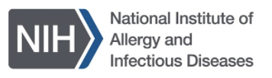
HVTN 706/HPX3002 Acknowledgements
Funders & Other Collaborators
Janssen Vaccines & Prevention, B.V.
NIAID/DAIDS
USAMRDC

